Slide 1
Generative Modelling
Lecture 8
Part 1
Generative AI for Computer Vision

Slide 2
Content
Generative Learning Models
Statistical Understanding
Maximum Likelihood
Density Estimation
Different Generative Models

Slide 3
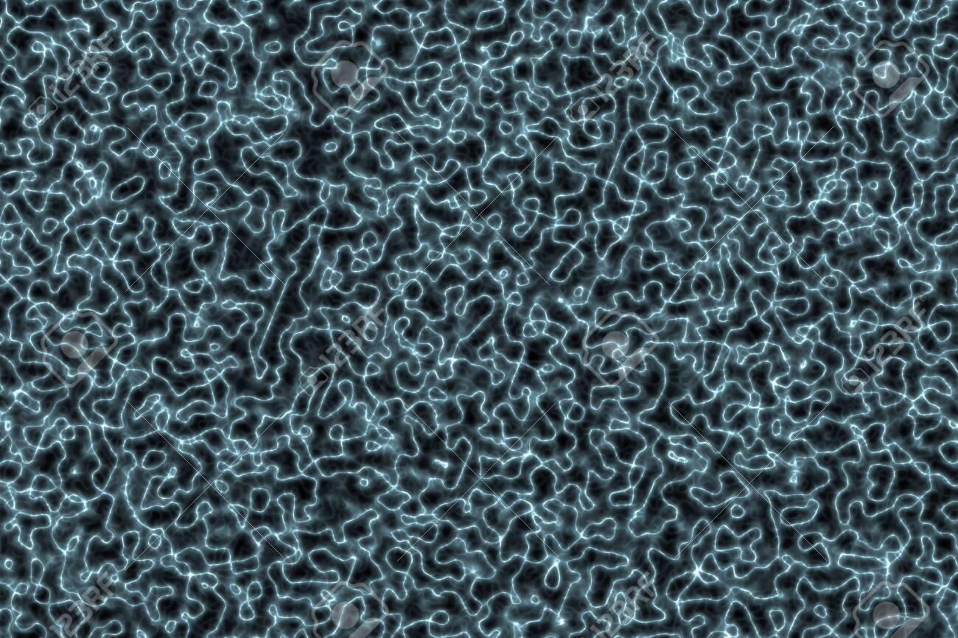
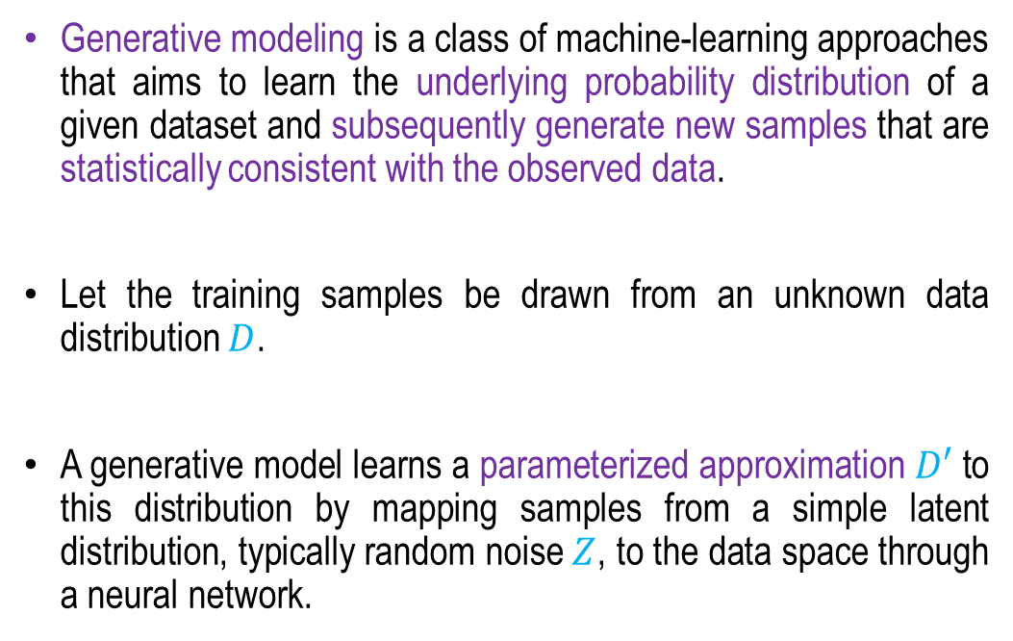
Generative Modelling
p(z) ~ Z
Random noise
Generative modeling is a class of machine-learning approaches that aims to learn the underlying probability distribution of a given dataset and subsequently generate new samples that are statistically consistent with the observed data.
Let the training samples be drawn from an unknown data distribution $D$.
A generative model learns a parameterized approximation $D′$ to this distribution by mapping samples from a simple latent distribution, typically random noise $Z$, to the data space through a neural network.
Generative Model
(Neural Net) G
Generated data
distribution
D’=G(Z)=I’(x)
Real data distribution
D=I(x)
Loss (Statistical Distance between D and D’ distributions)

Slide 4
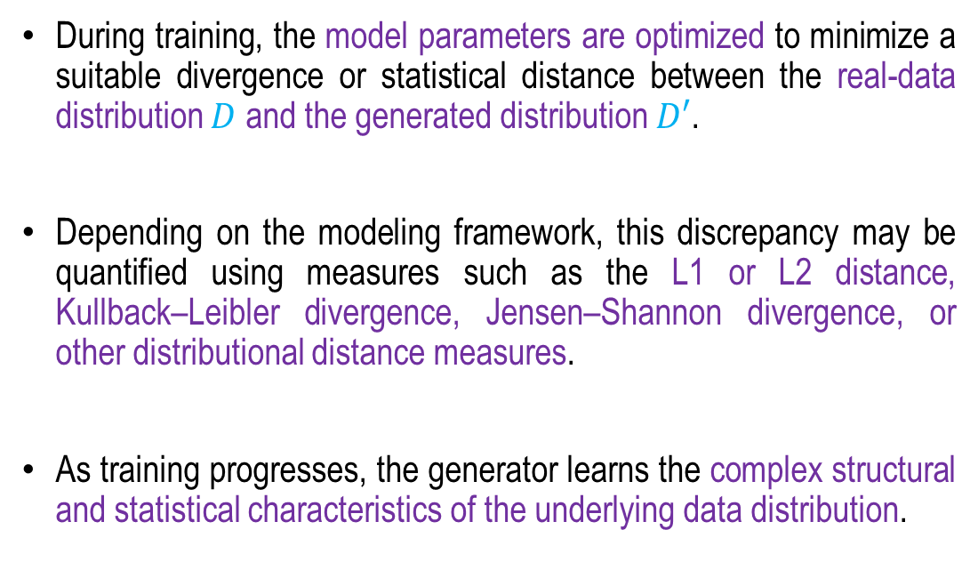
Generative Modelling
p(z) ~ Z
Random noise
During training, the model parameters are optimized to minimize a suitable divergence or statistical distance between the real-data distribution $D$ and the generated distribution $D′$.
Depending on the modeling framework, this discrepancy may be quantified using measures such as the L1 or L2 distance, Kullback–Leibler divergence, Jensen–Shannon divergence, or other distributional distance measures.
As training progresses, the generator learns the complex structural and statistical characteristics of the underlying data distribution.
Generative Model
(Neural Net) G
Generated data
distribution
D’=G(Z)=I’(x)
Real data distribution
D=I(x)
Loss (Statistical Distance between D and D’ distributions)

Slide 5
Generative Modelling
p(z) ~ Z
Random noise
Once adequately trained, the model can transform previously unseen random noise vectors into novel synthetic samples that closely approximate the characteristics of the original dataset while remaining distinct from the observed training samples.
Thus, generative modeling provides a powerful framework for learning complex data distributions and generating realistic, diverse, and statistically representative synthetic data.
Generative Model
(Neural Net) G
Generated data
distribution
D’=G(Z)=I’(x)
Real data distribution
D=I(x)
Loss (Statistical Distance between D and D’ distributions)

Slide 6
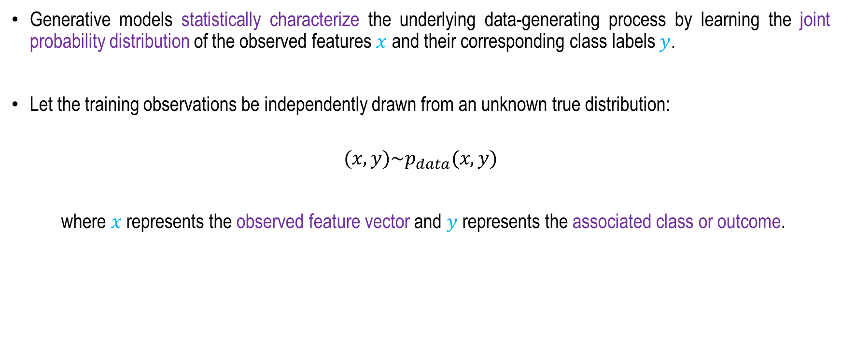
How Generative Model Works?
A statistical Understanding
Generative models statistically characterize the underlying data-generating process by learning the joint probability distribution of the observed features $x$ and their corresponding class labels $y$.
Let the training observations be independently drawn from an unknown true distribution:
$$(x,y)\sim p_{data}(x,y)$$
where $x$ represents the observed feature vector and $y$ represents the associated class or outcome.

Slide 7
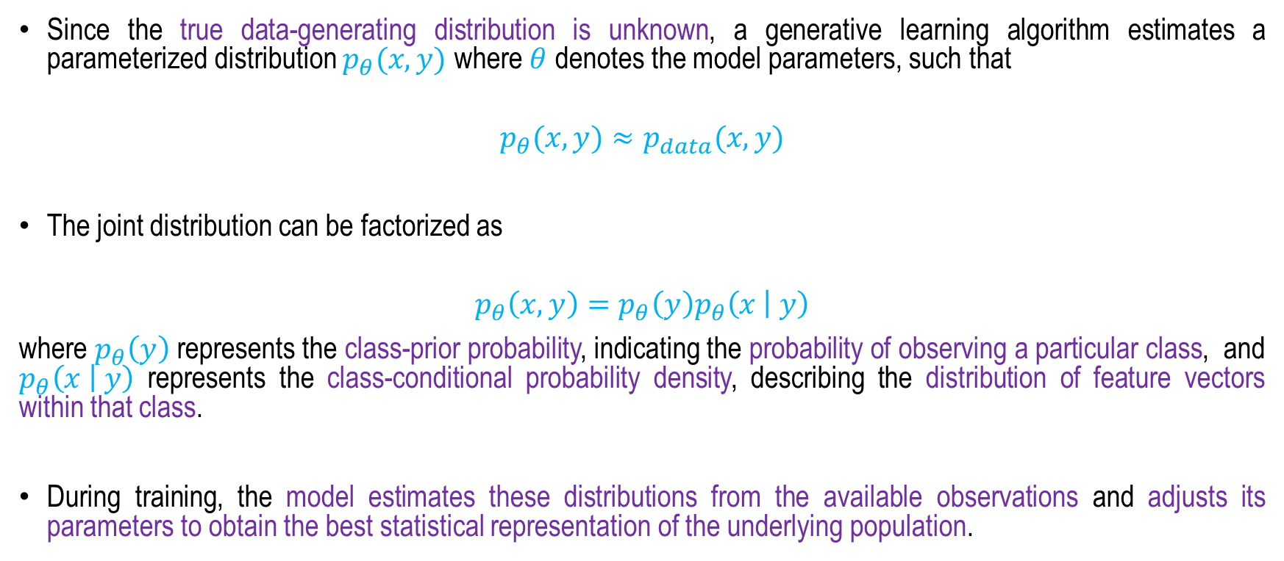
How Generative Model Works?
A statistical Understanding
Since the true data-generating distribution is unknown, a generative learning algorithm estimates a parameterized distribution $p_{θ}(x,y)$ where $θ$ denotes the model parameters, such that
$$p_{θ}(x,y)≈p_{data}(x,y)$$
The joint distribution can be factorized as
$$p_{θ}\left(x,y\right)=p_{θ}\left(y\right)p_{θ}\left(x | y\right)$$
where $p_{θ}\left(y\right)$ represents the class-prior probability, indicating the probability of observing a particular class, and $p_{θ}\left(x | y\right)$ represents the class-conditional probability density, describing the distribution of feature vectors within that class.
During training, the model estimates these distributions from the available observations and adjusts its parameters to obtain the best statistical representation of the underlying population.

Slide 8
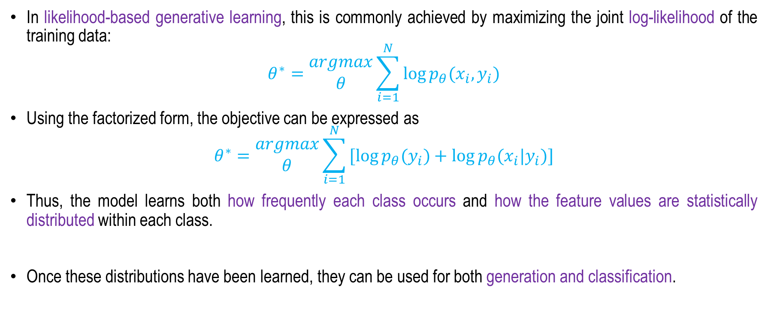
How Generative Model Works?
A statistical Understanding
In likelihood-based generative learning, this is commonly achieved by maximizing the joint log-likelihood of the training data:
$$θ^{∗}=\begin{matrix}argmax \\ θ\end{matrix}\sum_{i=1}^{N}{\log{p_{θ}(x_{i},y_{i})}}$$
Using the factorized form, the objective can be expressed as
$$θ^{∗}=\begin{matrix}argmax \\ θ\end{matrix}\sum_{i=1}^{N}{[\log{p_{θ}(y_{i})}+log{p_{θ}(x_{i}|y_{i})]}}$$
Thus, the model learns both how frequently each class occurs and how the feature values are statistically distributed within each class.
Once these distributions have been learned, they can be used for both generation and classification.

Slide 9
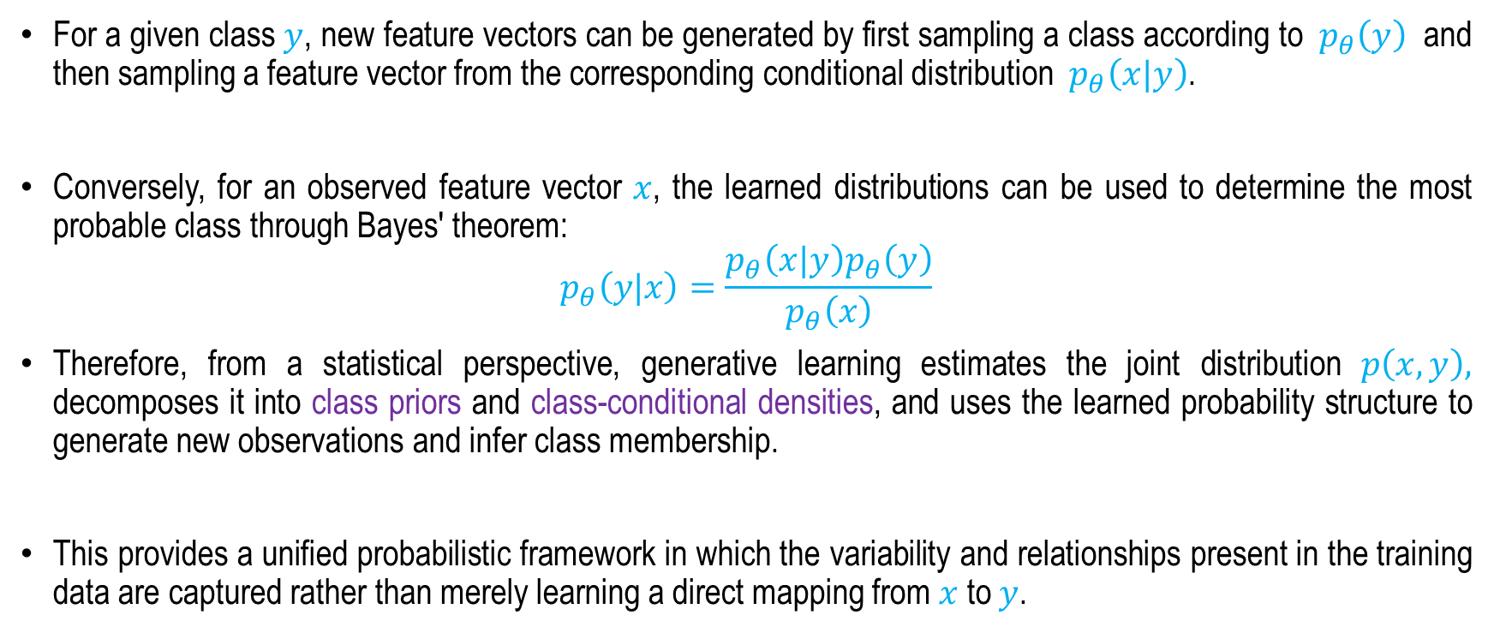
How Generative Model Works?
A statistical Understanding
For a given class $y$, new feature vectors can be generated by first sampling a class according to $p_{θ}\left(y\right)$ and then sampling a feature vector from the corresponding conditional distribution $p_{θ}\left(x|y\right)$.
Conversely, for an observed feature vector $x$, the learned distributions can be used to determine the most probable class through Bayes' theorem:
$$p_{θ}\left(y|x\right)=\frac{p_{θ}\left(x|y\right)p_{θ}\left(y\right)}{p_{θ}\left(x\right)}$$
Therefore, from a statistical perspective, generative learning estimates the joint distribution $p\left(x,y\right),$ decomposes it into class priors and class-conditional densities, and uses the learned probability structure to generate new observations and infer class membership.
This provides a unified probabilistic framework in which the variability and relationships present in the training data are captured rather than merely learning a direct mapping from $x$ to $y$.

Slide 10
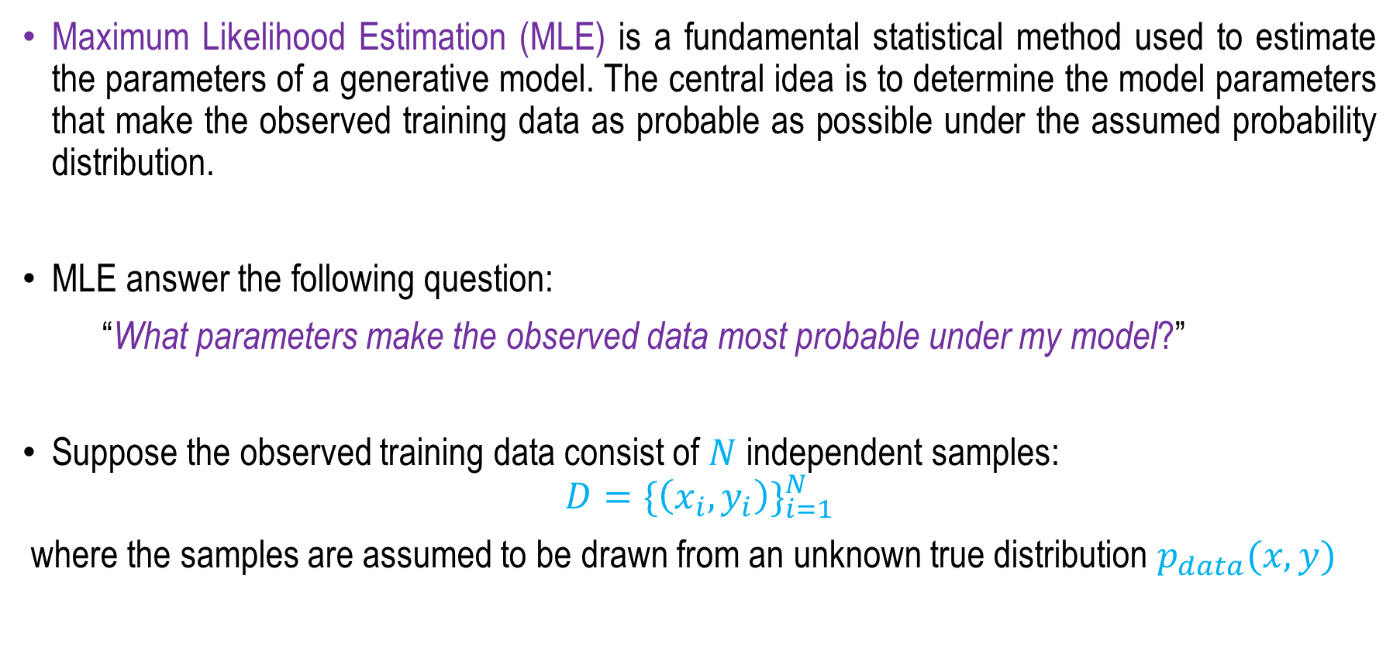
MLE in Generative Modeling
Maximum Likelihood Estimation (MLE) is a fundamental statistical method used to estimate the parameters of a generative model. The central idea is to determine the model parameters that make the observed training data as probable as possible under the assumed probability distribution.
MLE answer the following question:
“What parameters make the observed data most probable under my model?”
Suppose the observed training data consist of $N$ independent samples:
$$D={\{\left(x_{i},y_{i}\right)\}}_{i=1}^{N}$$
where the samples are assumed to be drawn from an unknown true distribution $p_{data}(x,y)$

Slide 11
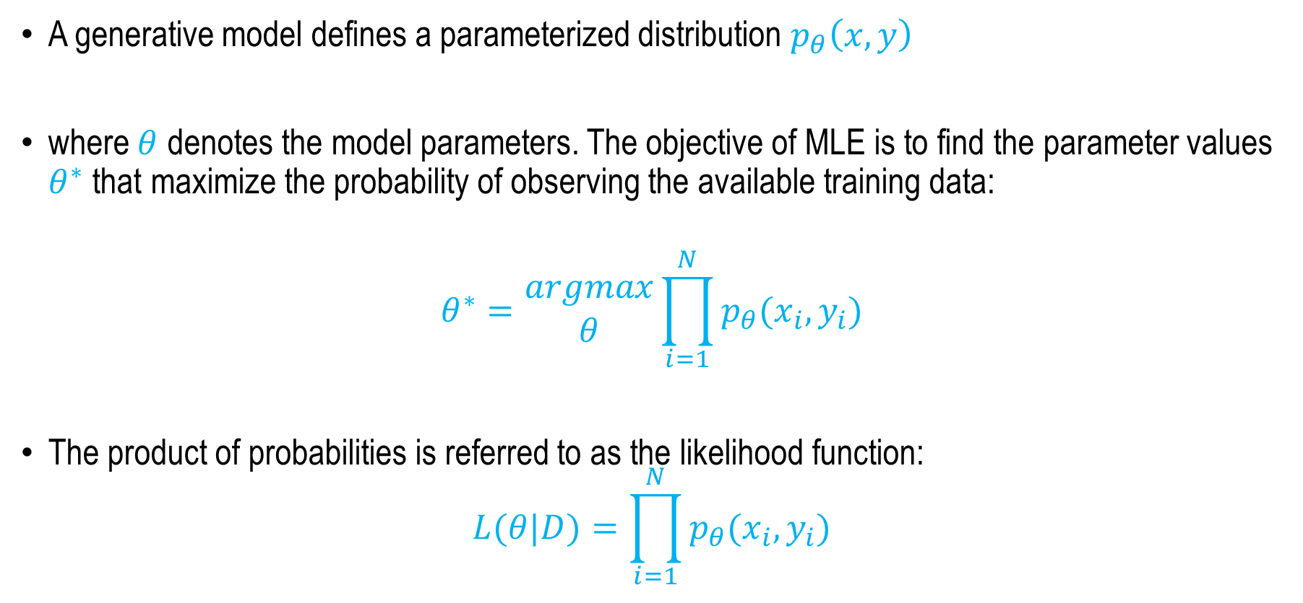
MLE in Generative Modeling
A generative model defines a parameterized distribution $p_{θ}\left(x,y\right)$
where $θ$ denotes the model parameters. The objective of MLE is to find the parameter values $θ^{∗}$ that maximize the probability of observing the available training data:
$$θ^{∗}=\begin{matrix}argmax \\ θ\end{matrix}\prod_{i=1}^{N}{p_{θ}(x_{i},y_{i})}$$
The product of probabilities is referred to as the likelihood function:
$$L(θ|D)=\prod_{i=1}^{N}{p_{θ}(x_{i},y_{i})}$$

Slide 12
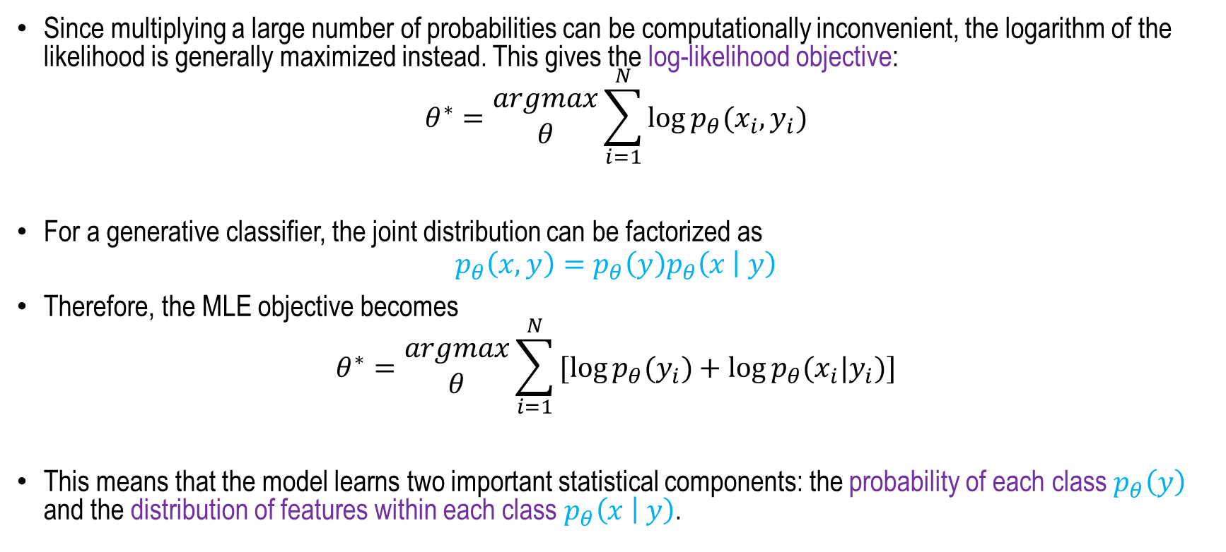
MLE in Generative Modeling
Since multiplying a large number of probabilities can be computationally inconvenient, the logarithm of the likelihood is generally maximized instead. This gives the log-likelihood objective:
$$θ^{∗}=\begin{matrix}argmax \\ θ\end{matrix}\sum_{i=1}^{N}{\log{p_{θ}(x_{i},y_{i})}}$$
For a generative classifier, the joint distribution can be factorized as
$$p_{θ}\left(x,y\right)=p_{θ}\left(y\right)p_{θ}\left(x | y\right)$$
Therefore, the MLE objective becomes
$$θ^{∗}=\begin{matrix}argmax \\ θ\end{matrix}\sum_{i=1}^{N}{[\log{p_{θ}(y_{i})}+log{p_{θ}(x_{i}|y_{i})]}}$$
This means that the model learns two important statistical components: the probability of each class $p_{θ}\left(y\right)$ and the distribution of features within each class $p_{θ}\left(x | y\right)$.

Slide 13
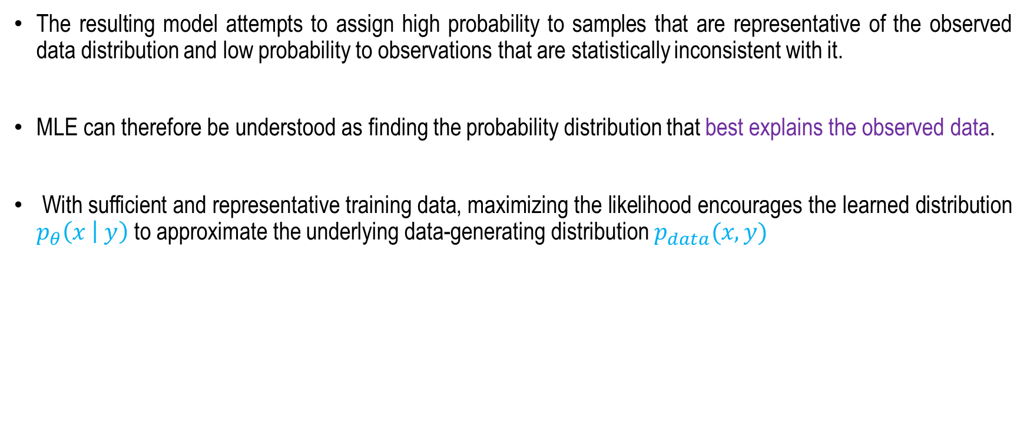
MLE in Generative Modeling
The resulting model attempts to assign high probability to samples that are representative of the observed data distribution and low probability to observations that are statistically inconsistent with it.
MLE can therefore be understood as finding the probability distribution that best explains the observed data.
With sufficient and representative training data, maximizing the likelihood encourages the learned distribution $p_{θ}\left(x | y\right)$ to approximate the underlying data-generating distribution $p_{data}(x,y)$

Slide 14
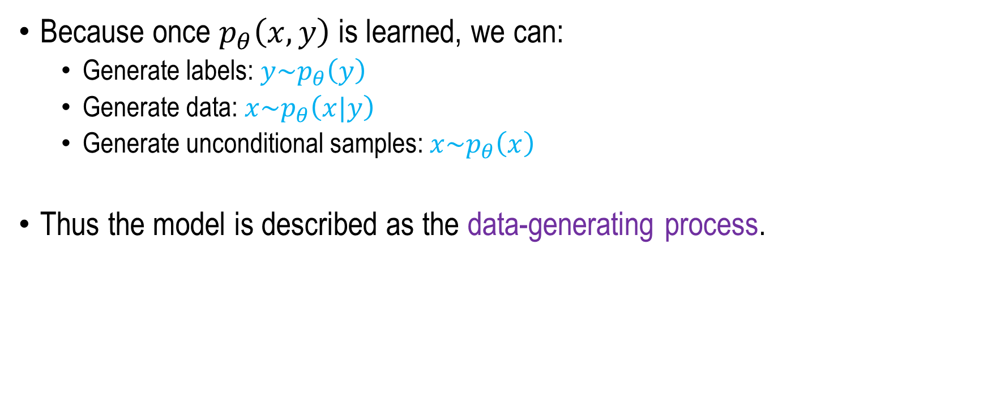
Why it is called Generative?
Because once $p_{θ}\left(x,y\right)$is learned, we can:
  Generate labels: ${y\sim p}_{θ}\left(y\right)$
  Generate data: ${x\sim p}_{θ}\left(x|y\right)$
  Generate unconditional samples: ${x\sim p}_{θ}\left(x\right)$
Thus the model is described as the data-generating process.

Slide 15
Three Main Types of Generative Models
Explicit Density Models: These are true density estimators.
  Autoregressive models
  Normalizing Flows
  Variational Autoencoders (VAEs)
Implicit Density Models: These do NOT compute p(x) explicitly.
  Generative Adversarial Network (GAN)
Score-Based / Diffusion Models: This is an implicit density estimation via score estimation.
  Denoising Diffusion Probabilistic Models (DDPM)
  Score Matching models

Slide 16
Different Generative Models
Tractable Density
Fully Visible Belief Nets
NADE
MADE
Pixel RNN
Change of variable models (nonlinear ICA)
Explicit Density
Markov Chain
Boltzmann Machine
Generative Models
Approximate Density
Variational
Variational Autoencoder
Direct
Implicit Density
GAN
Markov Chain
GSN
Figure copyright and adapted from Ian Goodfellow, Tutorial on Generative Adversarial Networks, 2017.

Slide 17
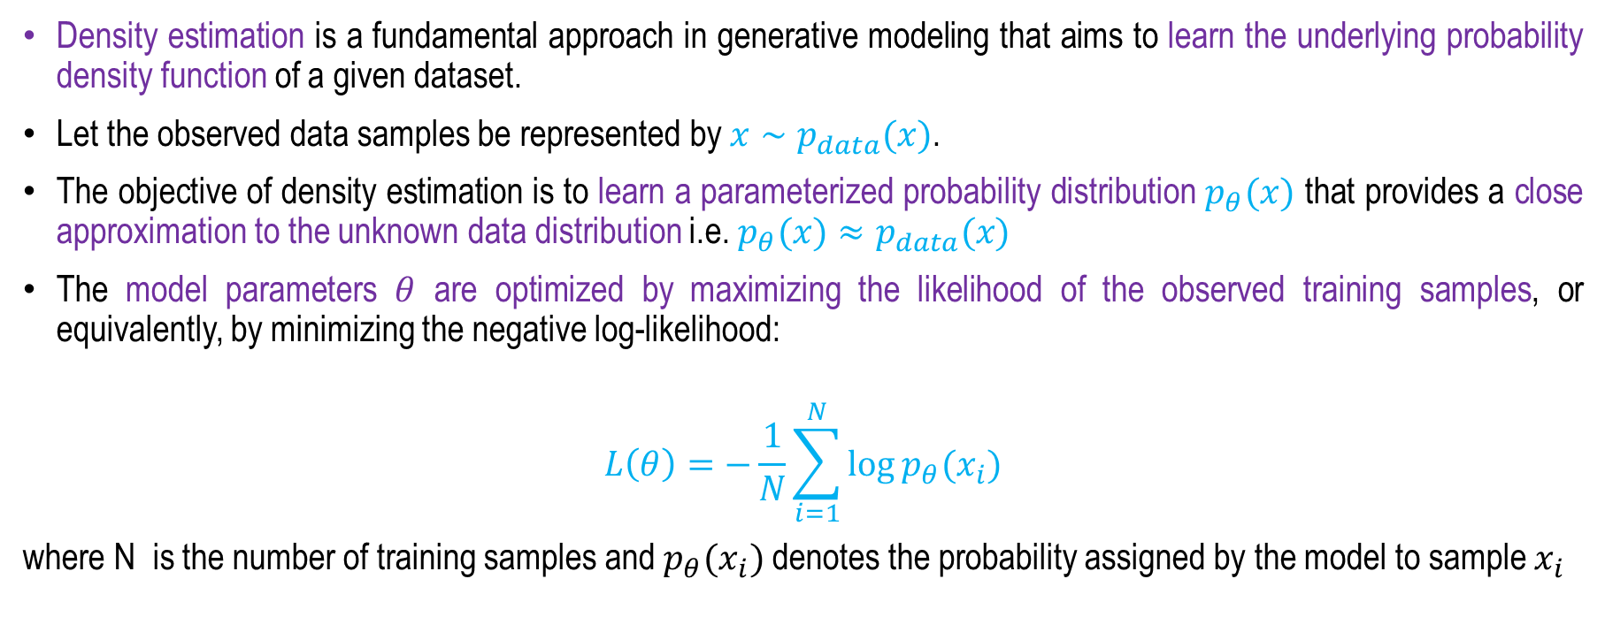
Density Estimation in Generative Modelling
Density estimation is a fundamental approach in generative modeling that aims to learn the underlying probability density function of a given dataset.
Let the observed data samples be represented by $x∼p_{data}(x)$.
The objective of density estimation is to learn a parameterized probability distribution $p_{θ}(x)$ that provides a close approximation to the unknown data distribution i.e. $p_{θ}(x)≈p_{data}(x)$
The model parameters $θ$ are optimized by maximizing the likelihood of the observed training samples, or equivalently, by minimizing the negative log-likelihood:
$$L\left(θ\right)=−\frac{1}{N}\sum_{i=1}^{N}{\log{p_{θ}(x_{i})}}$$
where N is the number of training samples and $p_{θ}(x_{i})$ denotes the probability assigned by the model to sample $x_{i}$

Slide 18
Density Estimation in Generative Modelling
Once the probability density has been learned, the model can be used not only to estimate the likelihood of new observations but also, depending on the generative architecture, to generate new samples that follow the learned distribution.
Density estimation is particularly useful when the underlying data exhibit complex, multimodal, or nonlinear characteristics that cannot be adequately represented by simple parametric distributions.
Generative models such as Gaussian Mixture Models (GMMs), Variational Autoencoders (VAEs), Normalizing Flows, and autoregressive models employ different strategies for estimating or representing the data distribution.

Slide 19
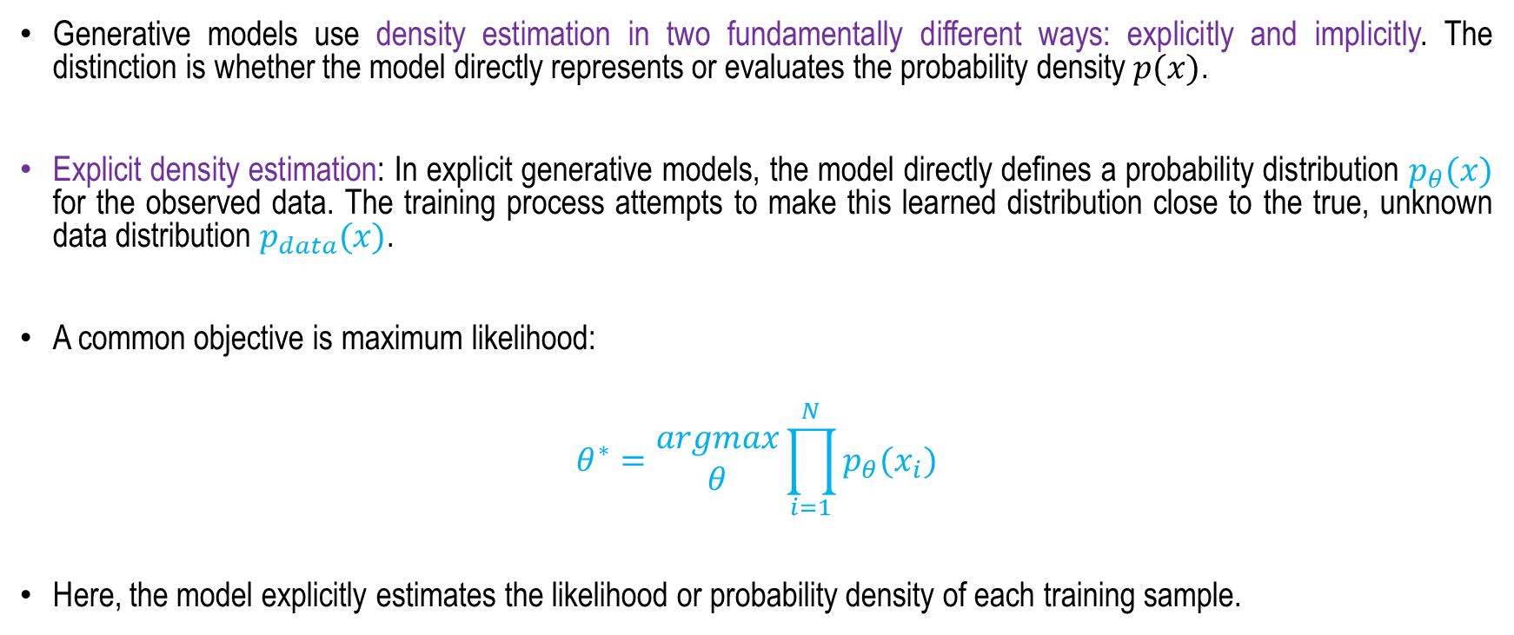
Explicit Density Estimation
Generative models use density estimation in two fundamentally different ways: explicitly and implicitly. The distinction is whether the model directly represents or evaluates the probability density $p(x)$.
Explicit density estimation: In explicit generative models, the model directly defines a probability distribution $p_{θ}(x)$ for the observed data. The training process attempts to make this learned distribution close to the true, unknown data distribution $p_{data}(x)$.
A common objective is maximum likelihood:
$$θ^{∗}=\begin{matrix}argmax \\ θ\end{matrix}\prod_{i=1}^{N}{p_{θ}(x_{i})}$$
Here, the model explicitly estimates the likelihood or probability density of each training sample.

Slide 20
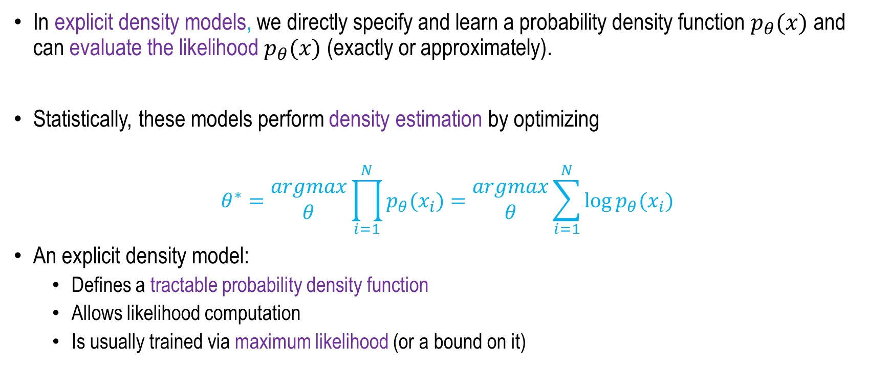
Explicit Density Models
In explicit density models, we directly specify and learn a probability density function $p_{θ}(x)$ and can evaluate the likelihood$p_{θ}(x)$ (exactly or approximately).
Statistically, these models perform density estimation by optimizing
$$θ^{∗}=\begin{matrix}argmax \\ θ\end{matrix}\prod_{i=1}^{N}{p_{θ}(x_{i})}=\begin{matrix}argmax \\ θ\end{matrix}\sum_{i=1}^{N}{\log{p_{θ}(x_{i})}}$$
An explicit density model:
  Defines a tractable probability density function
  Allows likelihood computation
  Is usually trained via maximum likelihood (or a bound on it)

Slide 21
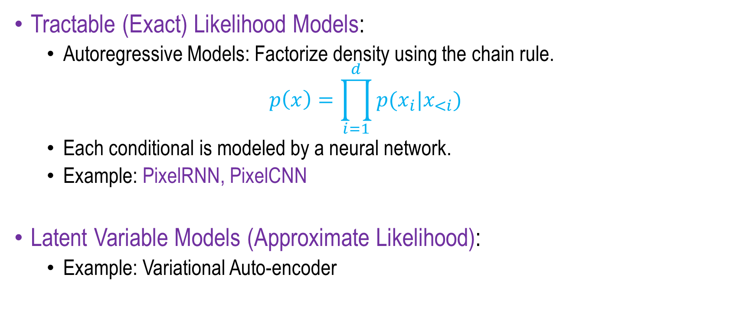
Explicit Density Models
Two main Categories
Tractable (Exact) Likelihood Models:
  Autoregressive Models: Factorize density using the chain rule.
  $$p\left(x\right)=\prod_{i=1}^{d}{p(x_{i}|x_{<i})}$$
  Each conditional is modeled by a neural network.
  Example: PixelRNN, PixelCNN
Latent Variable Models (Approximate Likelihood):
  Example: Variational Auto-encoder

Slide 22
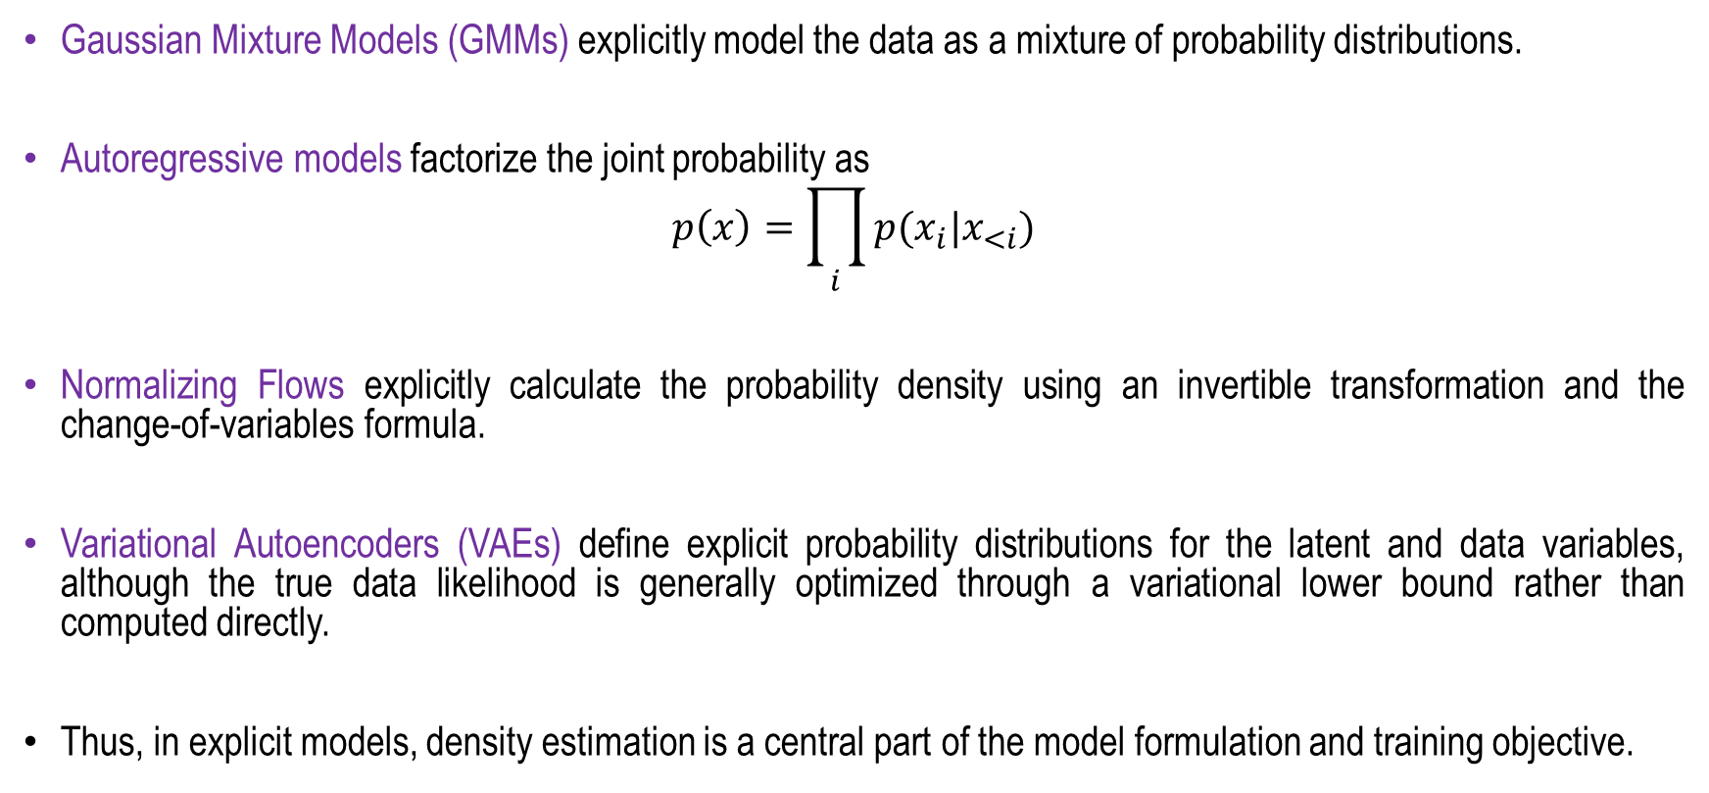
Explicit Density Estimation
Gaussian Mixture Models (GMMs) explicitly model the data as a mixture of probability distributions.
Autoregressive models factorize the joint probability as
$$p\left(x\right)=\prod_{i}{p(x_{i}|x_{<i})}$$
Normalizing Flows explicitly calculate the probability density using an invertible transformation and the change-of-variables formula.
Variational Autoencoders (VAEs) define explicit probability distributions for the latent and data variables, although the true data likelihood is generally optimized through a variational lower bound rather than computed directly.
Thus, in explicit models, density estimation is a central part of the model formulation and training objective.

Slide 23
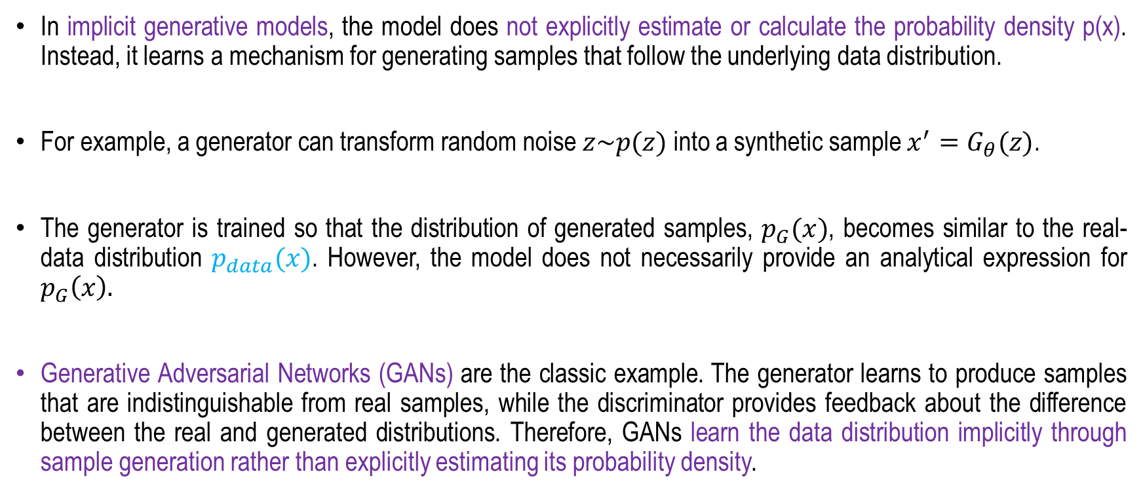
Implicit Density Estimation
In implicit generative models, the model does not explicitly estimate or calculate the probability density p(x). Instead, it learns a mechanism for generating samples that follow the underlying data distribution.
For example, a generator can transform random noise $z\sim p(z)$ into a synthetic sample $x^{′}=G_{θ}(z)$.
The generator is trained so that the distribution of generated samples, $p_{G}(x)$, becomes similar to the real-data distribution $p_{data}(x)$. However, the model does not necessarily provide an analytical expression for $p_{G}\left(x\right).$
Generative Adversarial Networks (GANs) are the classic example. The generator learns to produce samples that are indistinguishable from real samples, while the discriminator provides feedback about the difference between the real and generated distributions. Therefore, GANs learn the data distribution implicitly through sample generation rather than explicitly estimating its probability density.

Slide 24
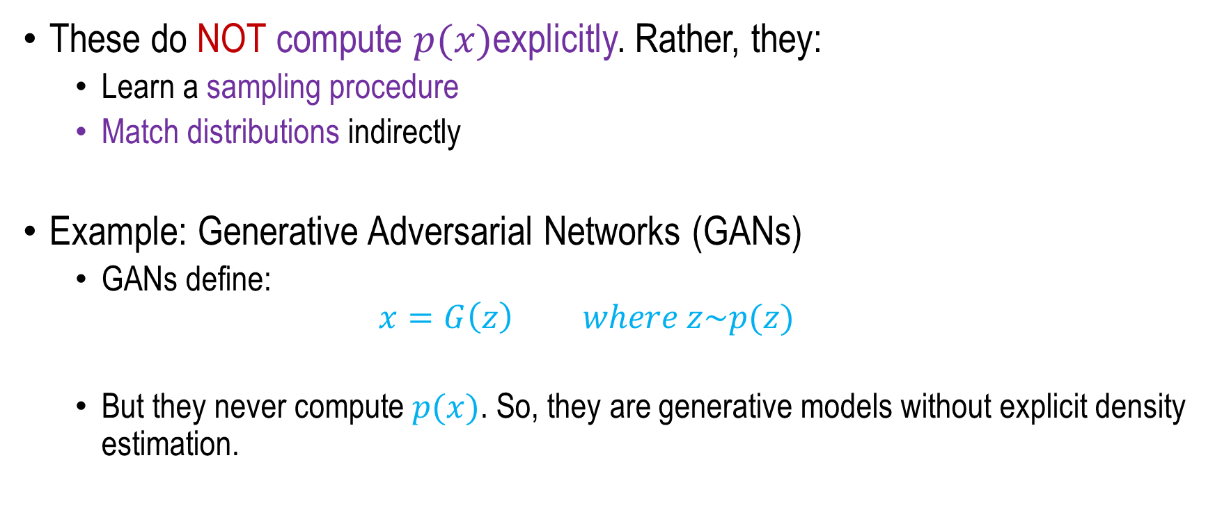
Implicit Density Models
These do NOT compute $p(x)$explicitly. Rather, they:
  Learn a sampling procedure
  Match distributions indirectly
Example: Generative Adversarial Networks (GANs)
  GANs define:
  $$x=G\left(z\right) where z\sim p(z)$$
  But they never compute $p(x)$. So, they are generative models without explicit density estimation.

Slide 25
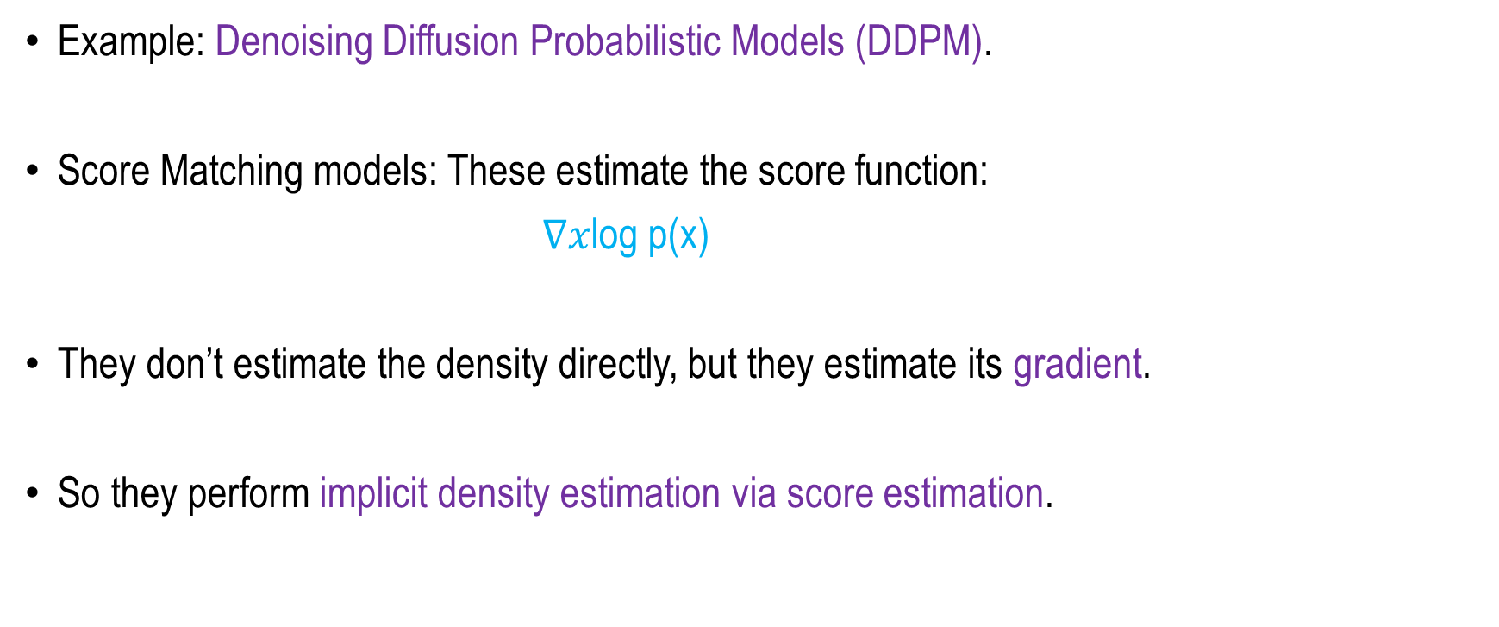
Score-Based / Diffusion Models
Example: Denoising Diffusion Probabilistic Models (DDPM).
Score Matching models: These estimate the score function:
$\text{∇}\text{x}\text{log} \text{p}\text{(}\text{x}\text{)}$
They don’t estimate the density directly, but they estimate its gradient.
So they perform implicit density estimation via score estimation.

Slide 26
Summary
Generative Learning Models
Statistical Understanding
Maximum Likelihood
Density Estimation
Different Generative Models

Slide 27
Auto-regressive Generative Models
Next
Lecture 8: Part 2
Generative AI for Computer Vision

